Slide 1
Machine Learning - Project 1
Joseph Bieselin – JAB975@nyu.edu

Slide 2
Goal
Use techniques to clean a dataset
Dataset is from College Scoreboard
Various information about certain colleges that receive federal funding
Prepare dataset for use in R
Use one machine learning algorithm learned in class
These consist of introductory ones such as linear regression, decision trees, SVM, etc.
Algorithms will be used to see if a student will have a debt greater than or equal to $25,000 upon graduation

Slide 3
Data Preparation – read in file
filepath<-"D:/Google Drive/School/Machine Learning/Project 1/output/MERGED2013_PP.csv"
data<-read.csv(filepath, header=TRUE, stringsAsFactors=FALSE)

Slide 4
Data Preparation – remove invalid contents
data.important <- cbind(data['TUITFTE'], data['ADM_RATE_ALL'], data['SATVRMID'], data['SATWRMID'], data['SATMTMID'], data['SAT_AVG_ALL'], data['GRAD_DEBT_MDN'])
data.clean <- data.important[!rowSums(data.important=='NULL'),]
dim(data.clean) # [1] 781 7

Slide 5
Data Preparation – convert to numerical data
data.clean$TUITFTE<-as.numeric(data.clean$TUITFTE)
data.clean$ADM_RATE_ALL<-as.numeric(data.clean$ADM_RATE_ALL)
data.clean$SATVRMID<-as.numeric(data.clean$SATVRMID)
data.clean$SATWRMID<-as.numeric(data.clean$SATWRMID)
data.clean$SATMTMID<-as.numeric(data.clean$SATMTMID)
data.clean$SAT_AVG_ALL<-as.numeric(data.clean$SAT_AVG_ALL)
data.clean$GRAD_DEBT_MDN<-as.numeric(data.clean$GRAD_DEBT_MDN)
# this introduces some NA values in the GRAD_DEBT_MDN column so remove those rows
data.clean<-data.clean[complete.cases(data.clean),]

Slide 6
Data Analysis – set up binary classifier field
set.seed(101)
# analysis will consist of determining if the GRAD_DEBT_MDN is greater than $25,000 or not
data.debtfactor<-data.clean
data.debtfactor$debtgt25k <- data.debtfactor$GRAD_DEBT_MDN > 25000.0

Slide 7
Data Analysis – get training and testing data
testset<-sample(nrow(data.debtfactor), round(0.3*nrow(data.debtfactor)), replace=FALSE)
traindata<-data.debtfactor[-testset,]
testdata<-data.debtfactor[testset,]

Slide 8
Data Analysis – logistic regression models
glm.model <- glm(debtgt25k ~ TUITFTE + ADM_RATE_ALL + SATVRMID + SATWRMID + SATMTMID, data=traindata, family="binomial")
glm.model.admission <-glm(debtgt25k ~ ADM_RATE_ALL, data=traindata, family="binomial")
glm.model.tution <-glm(debtgt25k ~ TUITFTE, data=traindata, family="binomial")

Slide 9
Data Analysis – analyzing models
## P-value for SAT score values are >0.05 so we do not reject the null hypothesis
## Null deviance, Residual deviance, and AIC are also high. This is not indication alone that the model is bad, but let us try to improve.
wald.test(b = coef(glm.model), Sigma = vcov(glm.model), Terms = 1:5)
anova(glm.model, test="Chisq")

Slide 10
Data Analysis – analyzing models
## P-value is < 0.05 so we reject the null hypothesis
## Residual Deviance and AIC also decreased which is a good sign
summary(glm.model.admission)
# perform predictions on the model using only admission rate
predicted<-predict(glm.model.admission, testdata, type="response")
predicted
auc<-prediction(predicted, testdata$debtgt25k)
perform<-performance(auc, measure="tpr", x.measure="fpr")
plot(perform, main="Debt after Graduation prediction glm - plot(perform)")

Slide 11
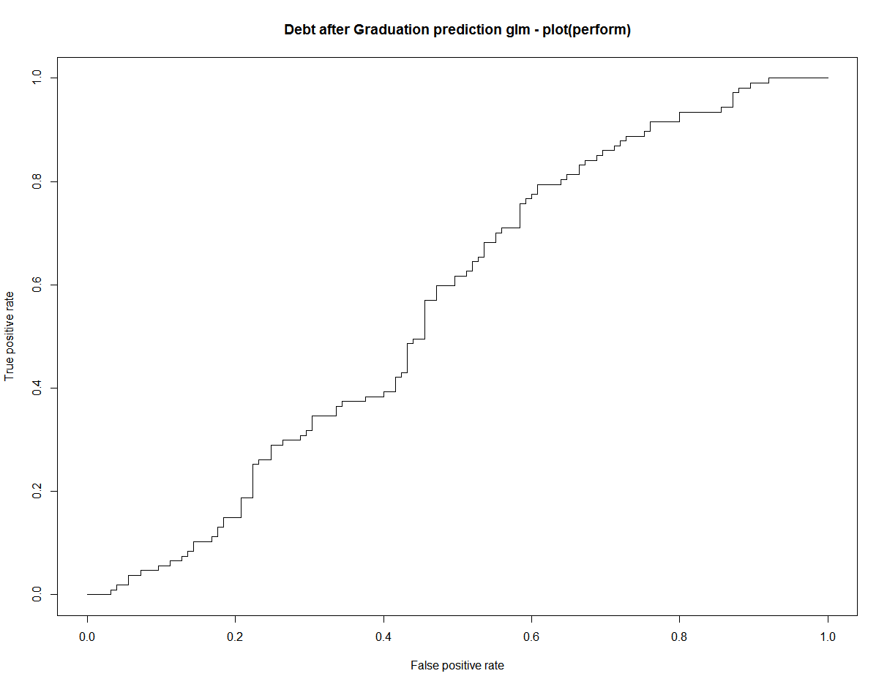
Data Analysis – AUC for glm.model.admission

Slide 12
Data Analysis – analyzing models
## P-value is > 0.05 so we do not reject the null hypothesis
# use just the tuition for logistic regression formula
glm.model.tution <-glm(debtgt25k ~ TUITFTE, data=traindata, family="binomial")
summary(glm.model.tuition)

Slide 13
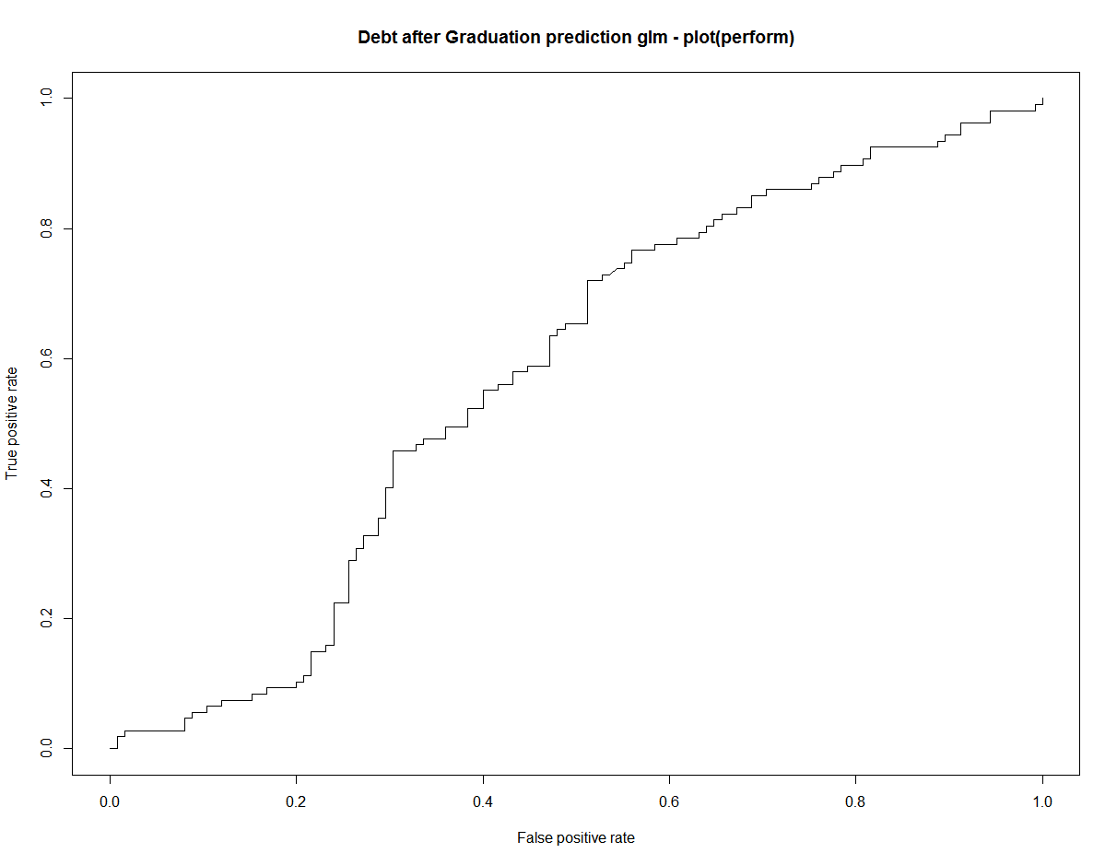
Data Analysis – AUC for glm.model.tuition

Slide 14
Summary – logistic regression
Not enough valuable results
No model performed extremely well or showed anything new
Try Random Forests

Slide 15
Data Analysis – random forest function
# Random Forests need factors for the fields, so get the factors
extractFeatures <- function(data) {
features <- c("TUITFTE",
"ADM_RATE_ALL",
"SATVRMID",
"SATWRMID",
"SATMTMID"
# ,"SAT_AVG_ALL"
)
fea <- data[,features]
return(fea)
}

Slide 16
Data Analysis – random forest function
set.seed(101) # reset the seed
# run the randomForest algo
randomForest.model <- randomForest(extractFeatures(traindata), as.factor(traindata$debtgt25k), ntree=100, importance=TRUE)
# look at the importance of the variables
varImpPlot(randomForest.model)

Slide 17
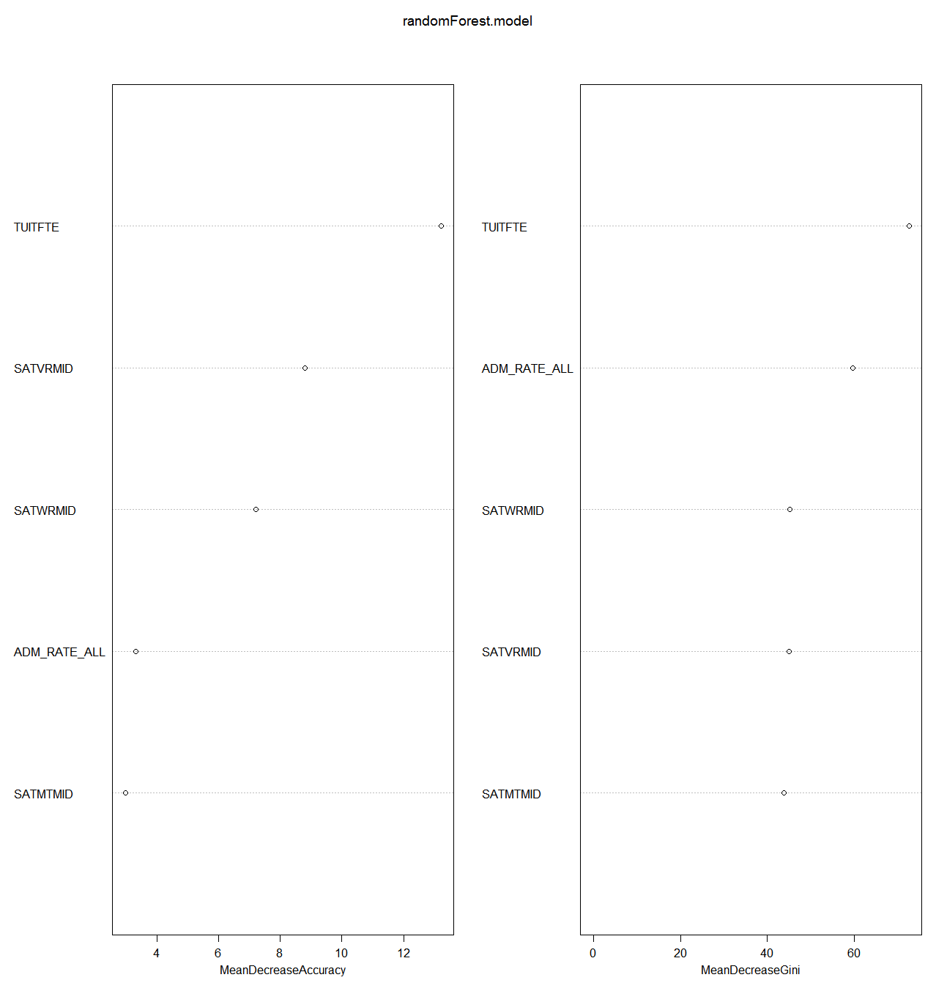
Data Analysis – variable importance for random forest

Slide 18
Conclusion
Random Forest showed that tuition is the most accurate predictor for having debt be greater than $25,000 upon graduation
Tuition is also the most useful for creating homogeneity in the trees
This is based on the fact that the Gini index relays homogeneity/heterogeneity information and tuition had the largest impact on this
This means it helps reach leaf nodes where a binary classification can be made
Linear Regression did not create useful models to predict test data from the models I trained

